Slide 1
MyComplaint
“mobile applications that solve real business and community challenges…”

Slide 2
MyComplaint
Current Scenario: Background Information
60% of complaints are made through phone calls
20% of complaints are made through web sites (online)
20% of complaints are made via ‘walk-ins’
Every year, 20,000 complaints are made for different categories
50% to 60% of complaints are not channeled to the relevant departments in a timely manner
Complaint information is inaccurate
Ultimately, there are delays in troubleshooting complaints due to the inaccurate information
There will be inconsistencies, delays, even confusion and increased costs and wastage in deploying resources ineffectively and inefficiently

Slide 3
MyComplaint
Project Objectives
The primary objectives of this project are to :
Increase and improve the level of public / community care and attention
Move towards greater degree of public satisfaction
Motivate, Encourage and Harvest/Collect more accurate information for any type of complaint
Introduce a more effective method of ‘problem spotting and identification’ distribution
Inject a more efficient communication service that the public will be ‘incentivized’ to use
Help to boost the trust and confidence of the ‘rakyat’ / target users
C | Communicate
A | Attention to Detail
R | Responsiveness
E | Engagement

Slide 4
MyComplaint
Project Benefits
Higher accuracy of complaint information is received from the public
Faster response time: more accurate complaint information received will pave the way for faster support and troubleshooting to be provided
Greater transparency : Complaints status can be literally viewed at your ‘fingertips’. Anytime & anywhere
Trust and confidence levels of the general public will be vastly improved
Auto Identification: These complaints will be forwarded to the correct and relevant departments based on location boundaries
Indirectly helps to improve the overall infrastructure as resources are designed and deployed more efficiently and effectively with optimum results

Slide 5
MyComplaint
Methodology
Agile method – Mobile D methodology
Explore
Initialize
‘Productionize’
Stabilize
System Test & Fix
The aim is to establish initial project as well as to prepare foundation for future development.
Includes implementation of required functionalities using iterative and incremental development cycle.
Review whether the application is developed according to requirement of client and whether it contains all required functionalities.
The purpose of this stage is to describe and prepare all components of application, as well as to predict critical issues of project.
The goal is to finalize the implementation , including integrating subsystems
if needed.

Slide 6
MyComplaint
Technology Benchmarking
There are three different technologies that can create imperative mobile apps
Web Apps /HTML 5
Native Tech
Hybrid Tech
The New generation smartphones come with powerful browser and support HTML5 , CSS3 and advance script.
This type does not need a container app to run it.
It will directly interact with the mobile operating system.
Can use API’s provided by the OS vendor (android/IOS).
This type is used to develop a very flexible mobile application combining the web and native elements.
For the MyComplaint Mobile app, the Hybrid technology is used for development due to:
Application Performance
Integration with Mobile OS API’s
UI level using HTML5

Slide 7
MyComplaint
Project Deliverables
Concept
Design
Develop
Testing
Release
Support
Brainstorm and discuss
application concept ideas.
Outline design and
development process.
Deliverable
Concept Specification
Design Team
Develop user interface Wireframes.
Review and refine wireframes until the design is complete.
Select platforms: iOS,
Android.
Deliverable
Application Design Specification
Development Team :
Determine, assign and complete development tasks.
Regular “show & tell” meetings monitoring progress.
Deliverable
Alpha & beta version of the apps
Development Team :
Develop testing plan.
Setup Issue tracking tool
Perform testing and bug-fix cycles.
Identify in-house testers.
Identify end-user testers.
Deliverable
Testing Plan Issue tracker.
Development Team and marketing team :
Submission to online stores, iTunes, Android Marketplace.
Build web page(s) to publicize and to host link
Identify tier 1 support
Contact.
Identify tier 2 support
Contact.
Deliverable
Materials for App Store
Submission.
Track downloads.
Handle Support issues.
Initiate additional publicity if required.
Deliverable
Download stats.

Slide 8
MyComplaint
Process Flow
Maps Views
Mobile Apps
Management
Dashboard
Tracking Performance
Public Users
Analytical Platform
Online Web / Helpdesk

Slide 9
MyComplaint
Registration Process
Google Play Store
Download apps
Install
Apple Store
Public Users
Fill in information
Phone no
Apply the KEY
Activation Mode
Receive SMS
IC No
Name
Start My Complaint

Slide 10
MyComplaint
Dashboard Layout
MyComplaint
Date : 26/01/2014
GPS
GPSRS
List of Draft complaints. Complaints that have not been submitted
Draft Complaint
List of complaints waiting for action
List of complaints already resolved
PENDING
RESOLVED
NEW
New complaints
Current Location : putrajaya presint 2

Slide 11
MyComplaint
New Complaint
MyComplaint
Date : 26/01/2014
Camera mode
Captured list. Allows user to choose the picture/image to send
Complaint location is captured automatically using GPS/GPRS mode
or allows manual input
Location/Address : putrajaya presint 2
Type of complaints
Rating :
Rating is to determine seriousness of the complaint
TYPE :
COMMENTS :
Save the complaint as Draft mode. Draft mode is useful when no internet or 3G connection is available to send the complaint
Detail of complaints
Send
Draft
Submit the complaints

Slide 12
MyComplaint
Pending/Resolved Complaints
MyComplaint
Date : 26/01/2014
Captured image
Complaint date
26/01/2014
Paip bocor……
Complaint rating
Comments
Resolved/Pending/In-progress
24/01/2014
status
Tong sampah bocor……
Resolved/Pending/In-progress

Slide 13
MyComplaint
Complaint Escalation Structure
Putrajaya/Presint 2
Putrajaya/Presint 3
Putrajaya/Presint 4

Slide 14
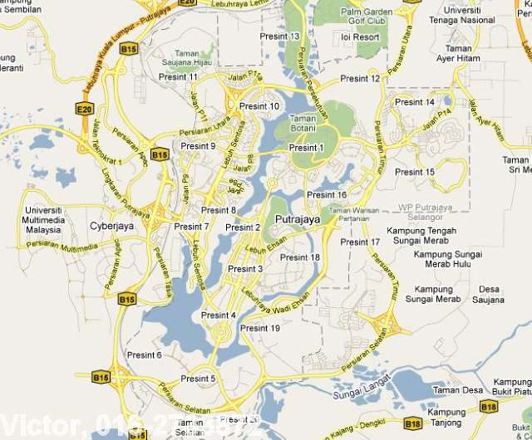
MyComplaint
MAPs
View on web browser , tablet, mobile
Based on login , the info on the Map will be displayed
The MAPs will show the summary of complaints in numbers
Summary is split into 4 categories :
30
In-progress with count
10
Pending with count
20
Resolved with count
20
New complaint - todate
Can view the details by clicking on points displayed on the maps

Slide 15
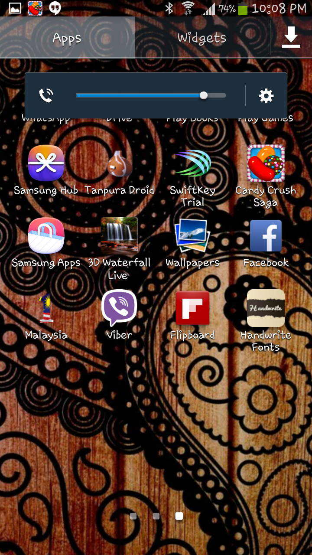
MyComplaint
Screen Shot - Prototype
Application Icon

Slide 16
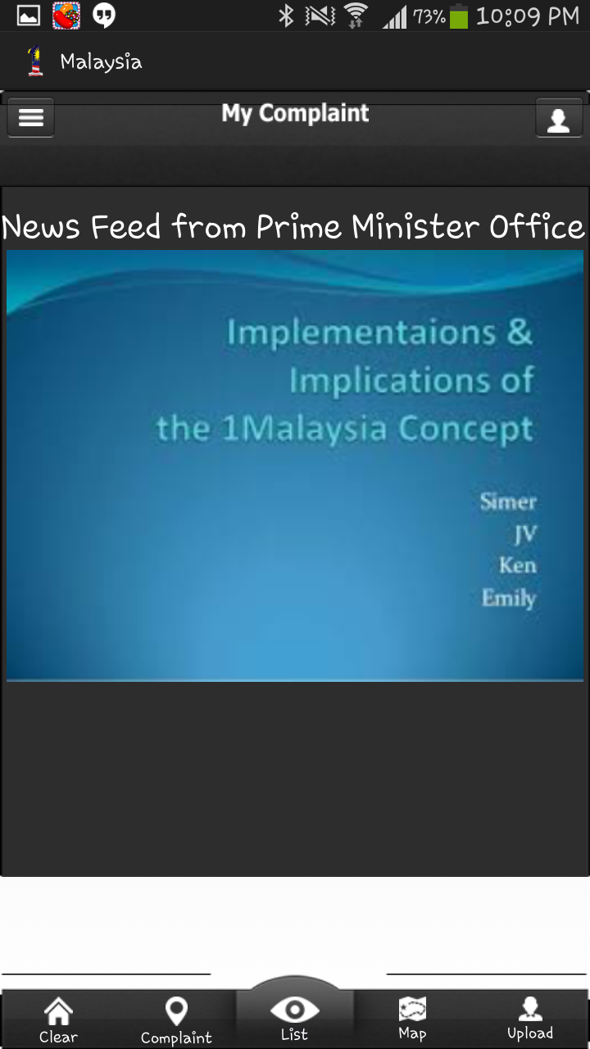
MyComplaint
Screen Shot - Prototype
Main Screen

Slide 17
MyComplaint
Screen Shot - Prototype
Main Screen
with ‘broadcast message’

Slide 18
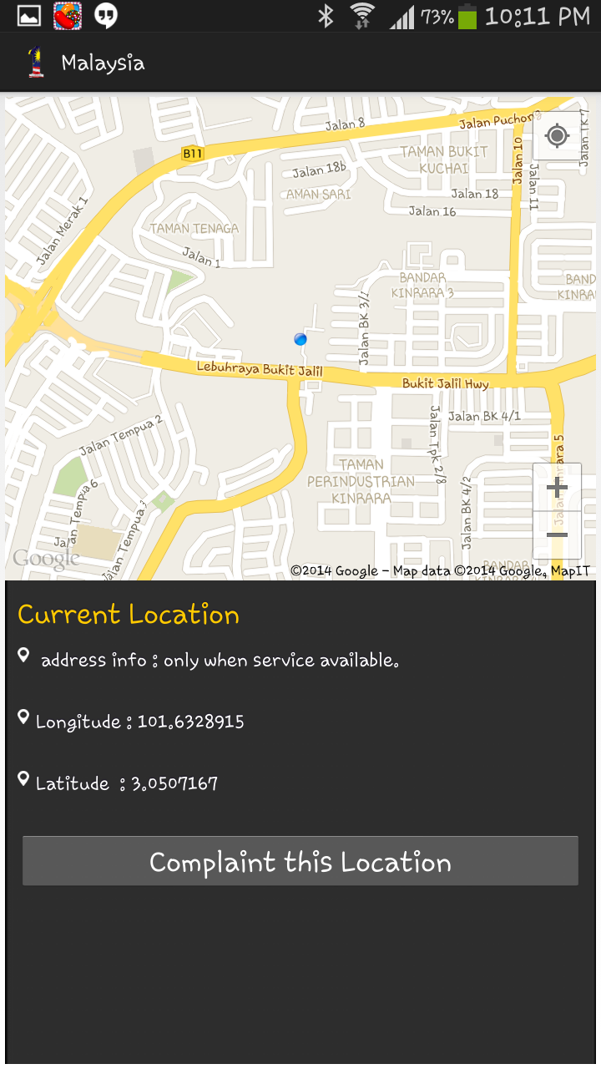
MyComplaint
Screen Shot - Prototype
GPRS
Captures the location
of the complaint

Slide 19
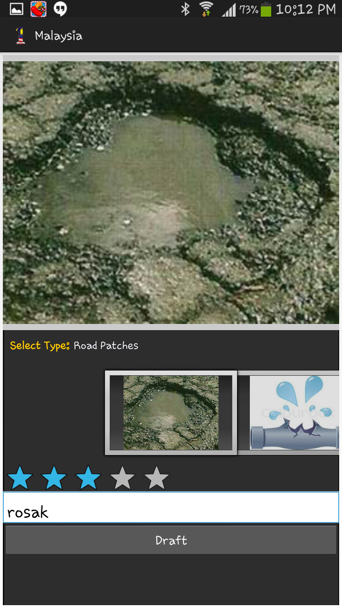
MyComplaint
Screen Shot - Prototype
Complaint Entry Screen

Slide 20
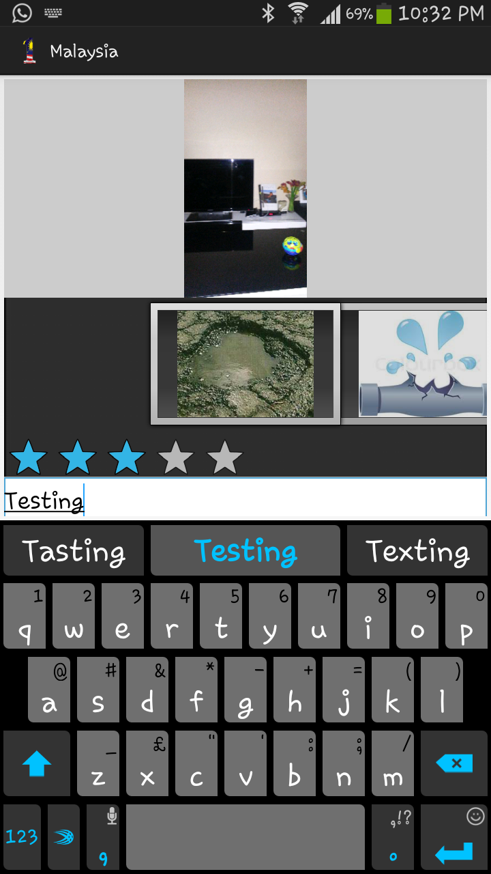
MyComplaint
Screen Shot - Prototype
Complaint Entry Screen
with photo capture

Slide 21
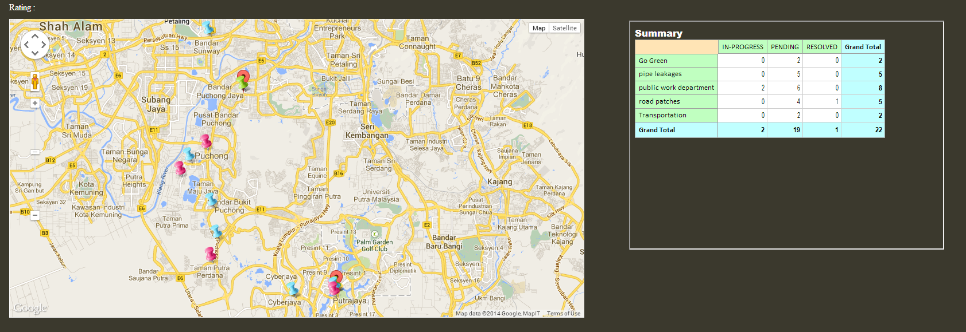
MyComplaint
Screen Shot – Complaint on Maps

Slide 22
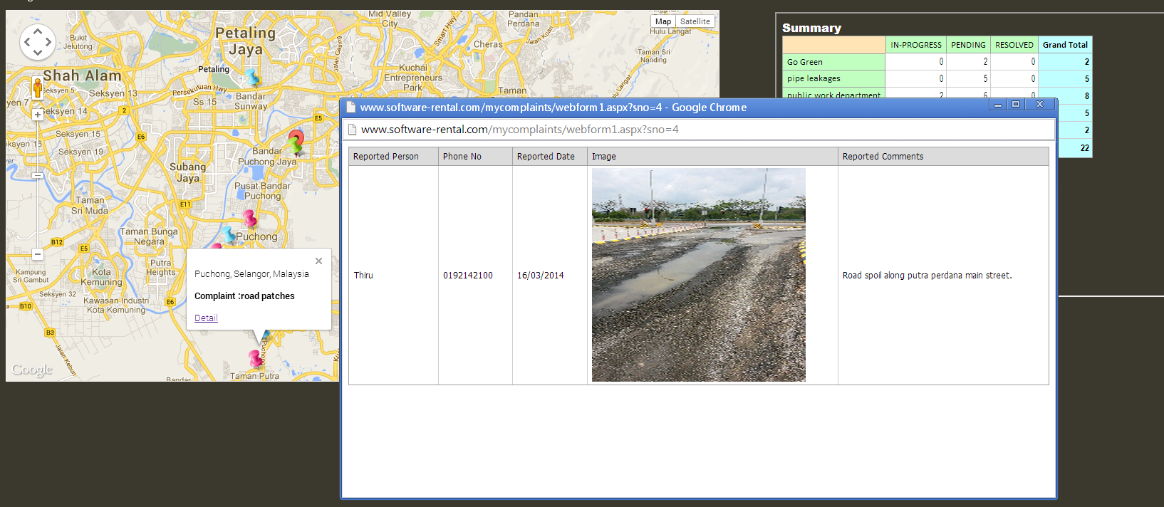
MyComplaint
Screen Shot – Complaint on Maps

Slide 23
MyComplaint
Helpdesk Integration
Complaint is captured via mobile application

Slide 24
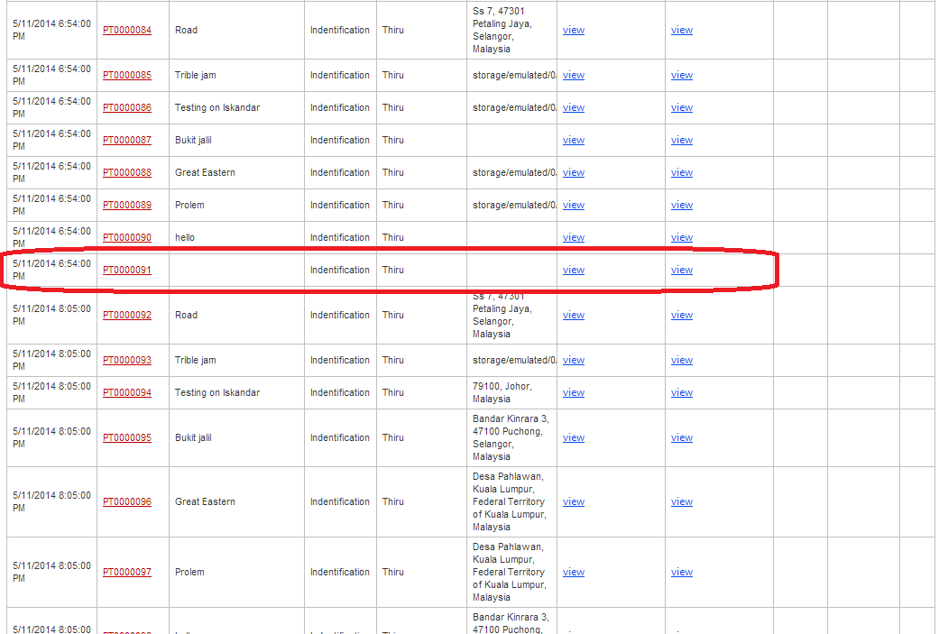
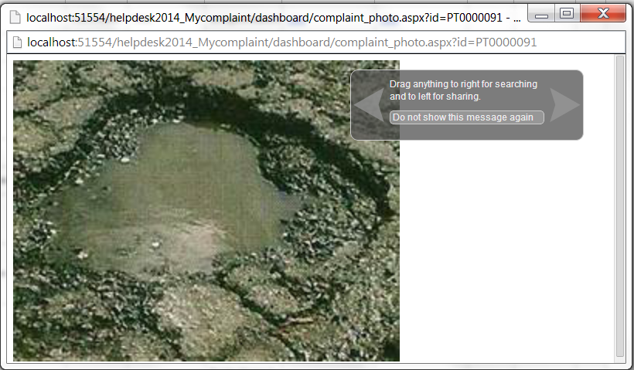
MyComplaint
Helpdesk Integration
Can view the captured image from mobile devices
via a helpdesk

Slide 25
MyComplaint

